Slide 1
MDP Processor
By: Hunter Vallad

Slide 2
Motivation
Assisting Professor Rosen with his dissertation
Little to no available options regarding computing MDPs easily

Slide 3
Background - MDP
MDP
Markov Decision Process
Math model for decision optimization
Time
States
Actions
Transition or Probability function
Reward function
Policy and Value iteration
Finite Horizon (Through backwards induction)

Slide 4
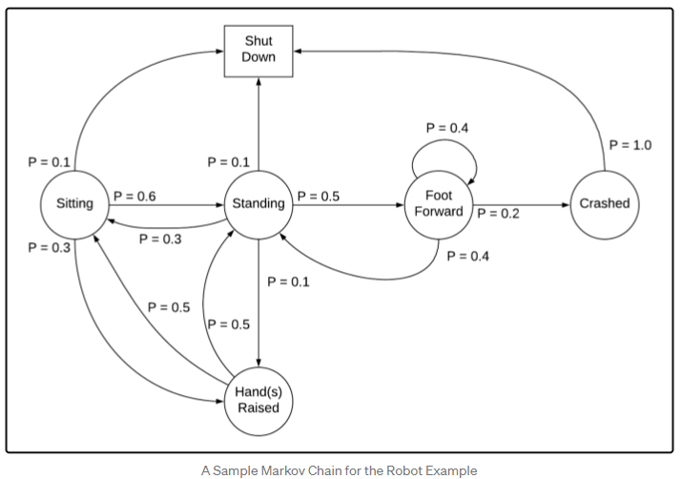
MDP Image Representation
https://towardsdatascience.com/understanding-the-markov-decision-process-mdp-8f838510f150

Slide 5
Background - Purpose
Purpose of the Application:
Import excel sheets representing transition and rewards functions
To compute Finite Horizon MDPs
Generate Optimal Policies

Slide 6
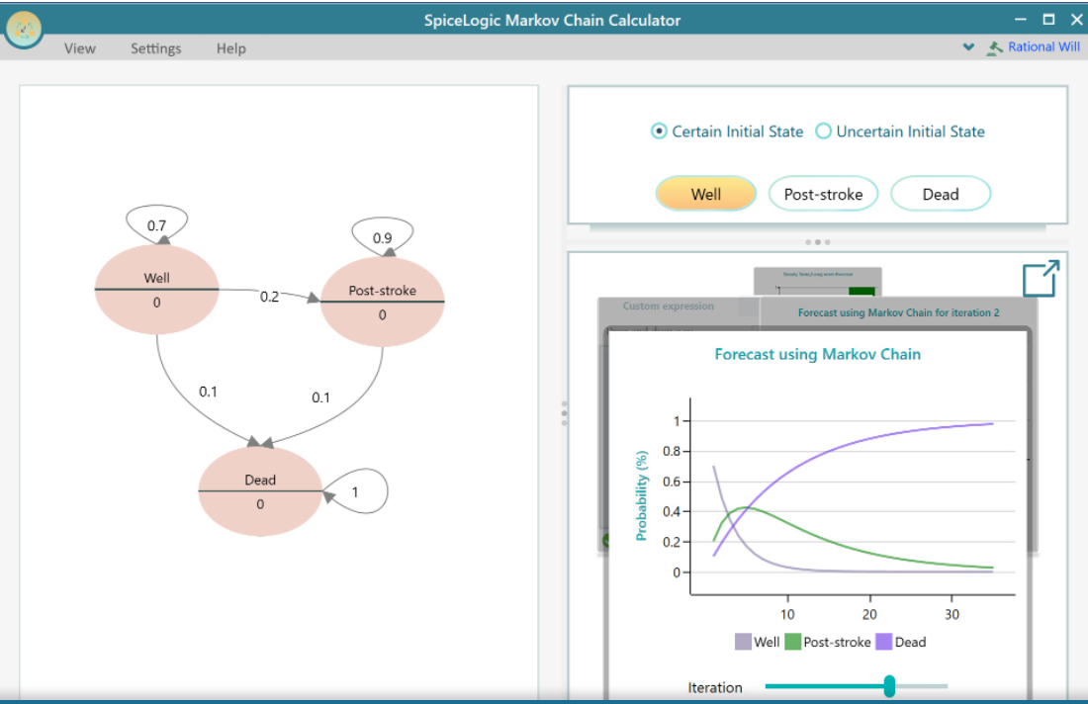
Background - Other Applications
Other Similar Software:
SpiceLogic Markov Chain Calculator
https://www.spicelogic.com/docs/RationalWill/markov-models/291
Excellent GUI
Problematic rewards structure
Does not easily allow rewards to be set per action per state

Slide 7
Project Management
What is completed:
Full working GUI
Importing and Exporting Features
Matrix editing
Discount Factor and Iteration Adjustments

Slide 8
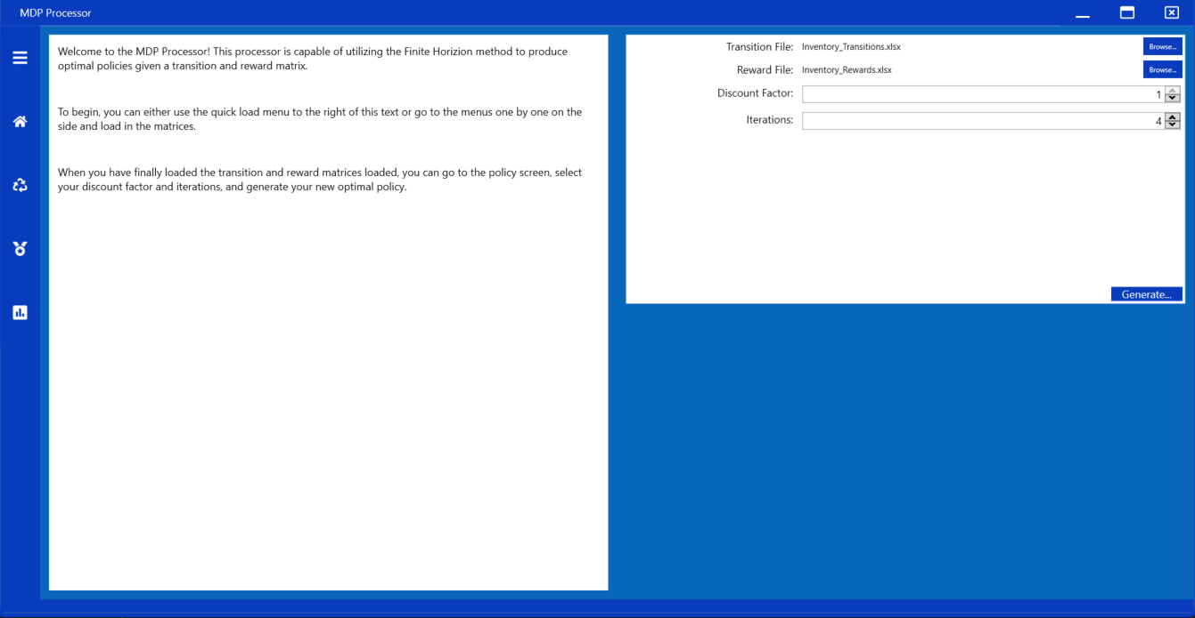
Project Management - Home

Slide 9
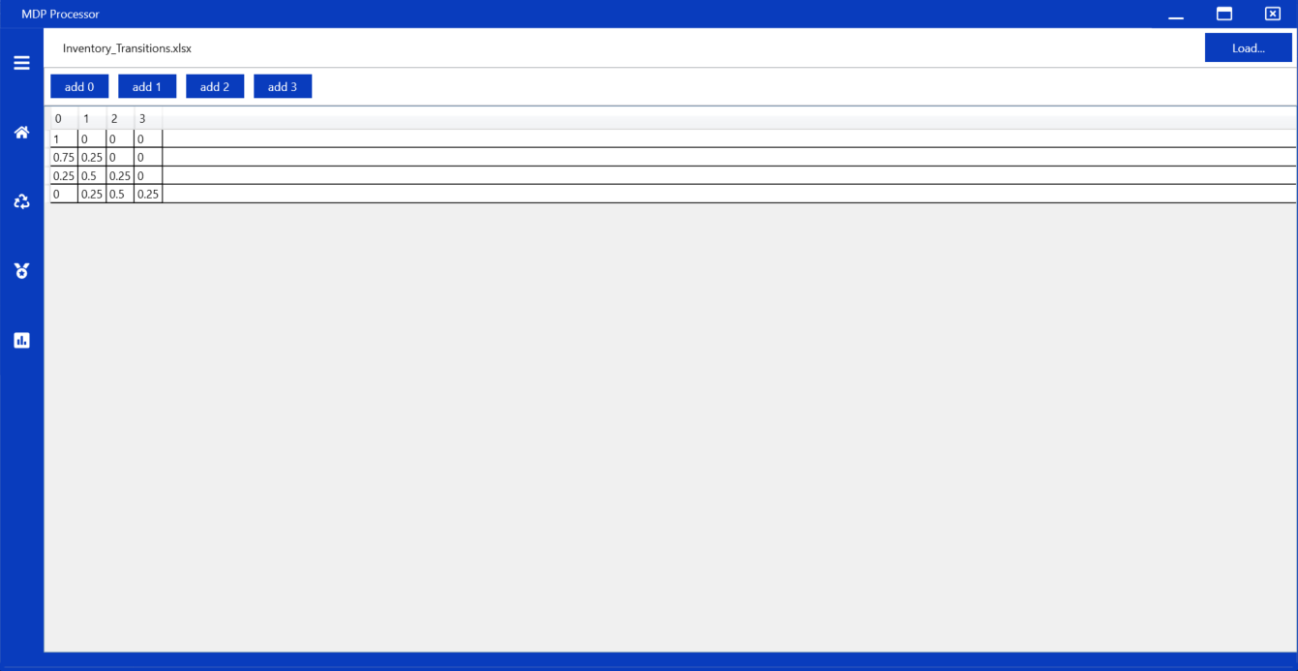
Project Management - Transition/Reward

Slide 10
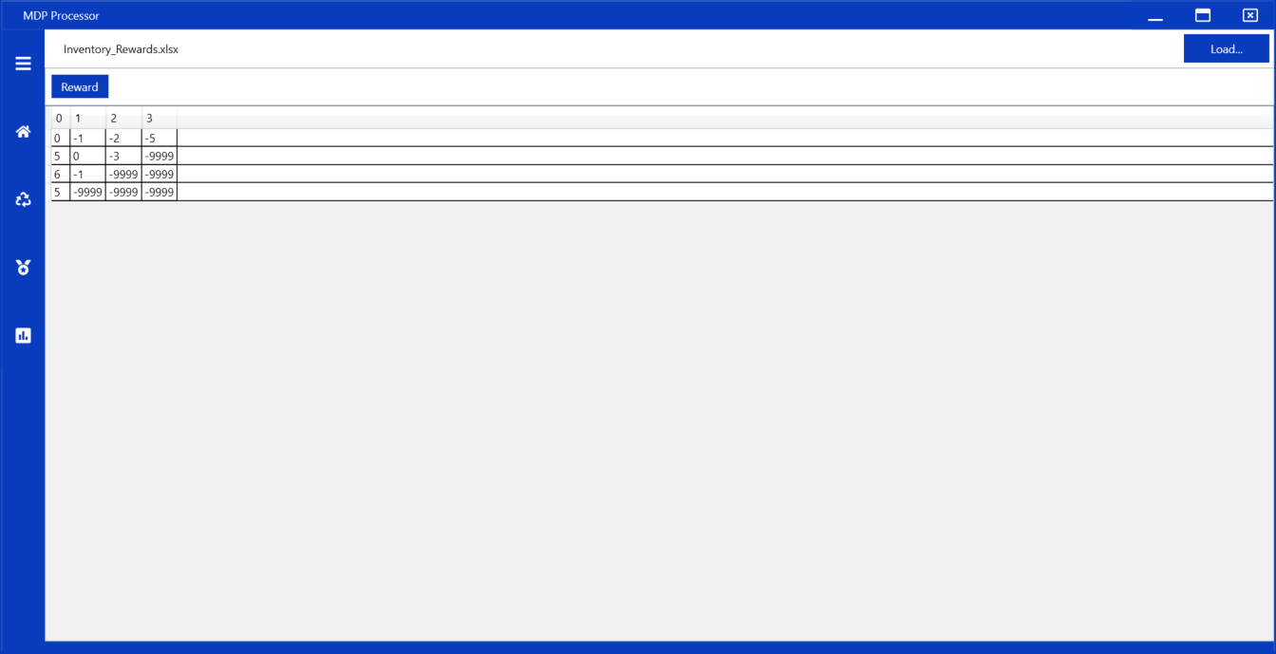
Project Management - Policy

Slide 11
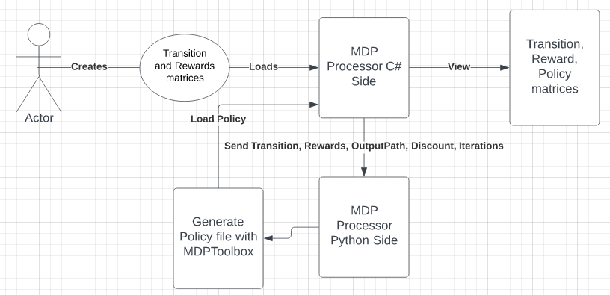
Application Architecture

Slide 12
Demo Time

Slide 13
Future Plans
Polish up the grid view
Write my own MDP library to perform the calculations
Move away from the python script
Add decision tree generation through the policies
Add multiple OS support my migrating to a different framework

Slide 14
Summary
Learned a lot about MDPs
Learned how to execute python from a c# application
Very powerful applications
Working application able to compute complex MDP models through Finite Horizon Value Iteration.

